Slide 1
Overview
Goal: How suitable are datasets for outlier detection benchmarking
Three methods used
Density Estimation
Parallel Plots
K-means Clustering

Slide 2
Readings
Basis Paper:
On the Evaluation of Unsupervised Outlier Detection: Measures, Datasets, and an Empirical Study
12 Outlier Detection Methods
Various Benchmarking Measures
How datasets where chosen, and normalized.
Papers On Various Outlier Detection Schemes
Goal: Get intuition & expectations on performance and & interest.
Papers on Various Clustering Methods:
Goal: Get some methods to use later on to learn more about datasets.
DBCAN, HDBCAN, OPTICS

Slide 3
Readings
Basis Paper:
On the Evaluation of Unsupervised Outlier Detection: Measures, Datasets, and an Empirical Study
12 Outlier Detection Methods
Various Benchmarking Measures
How datasets where chosen, and normalized.
Papers On Various Outlier Detection Schemes
Goal: Get intuition & expectations on performance and & interest.
Papers on Various Clustering Methods:
Goal: Get some methods to use later on to learn more about datasets.
DBCAN, HDBCAN, OPTICS

Slide 4
Preliminary Work
Looked Into Data Visualization For High Dimensional Data
Found Parallel Coordinates Plots Useful
Tried examining summary statistics
Generally wasn’t useful after conducting density estimation
Decided on basis for future analysis:
Use sample dataset with highest count of outliers
Try to use normalized, without duplicates, idf versions of datasets.

Slide 5
Density Estimation
Applied BMP truncated KDE on individual attributes of dataset.
This variant of KDE is pretty good for 1-D.
Goals:
Check distribution of attributes.
Check if any attributes are low resolution / discrete than stated.
Check for good separability between inliers and outliers.
Results:
Found many low resolution / possibility discrete attributes.
Estimates of “good” attributes were generally unimodal normal or power distributions.
Attributes individually didn’t consistently separate outliers.
In some datasets, outliers took a very small range of values comparatively

Slide 6
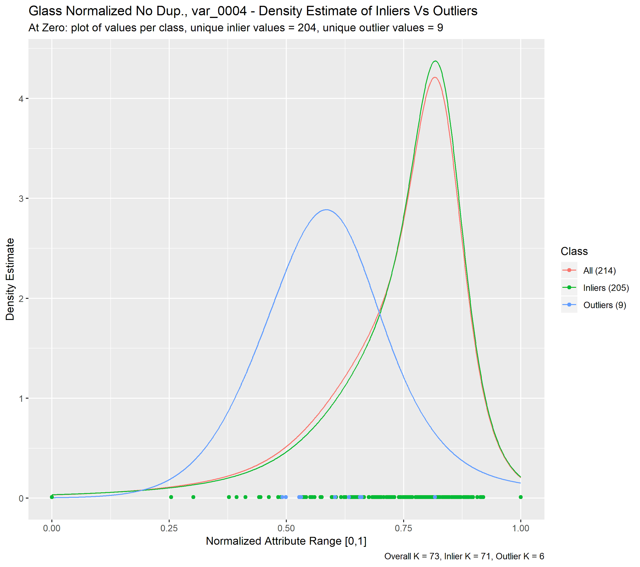
Density Estimation (Examples)
Glass – Type of Typical attribute, outliers show modest degree separability alone. This dataset consisted mostly of continuous normal distributions. In some outliers distributions were different than that of inliers.
Note the inlier value at 0.00, and that almost each inlier took a unique value for later. Suggests some inliers are also quite interesting.

Slide 7
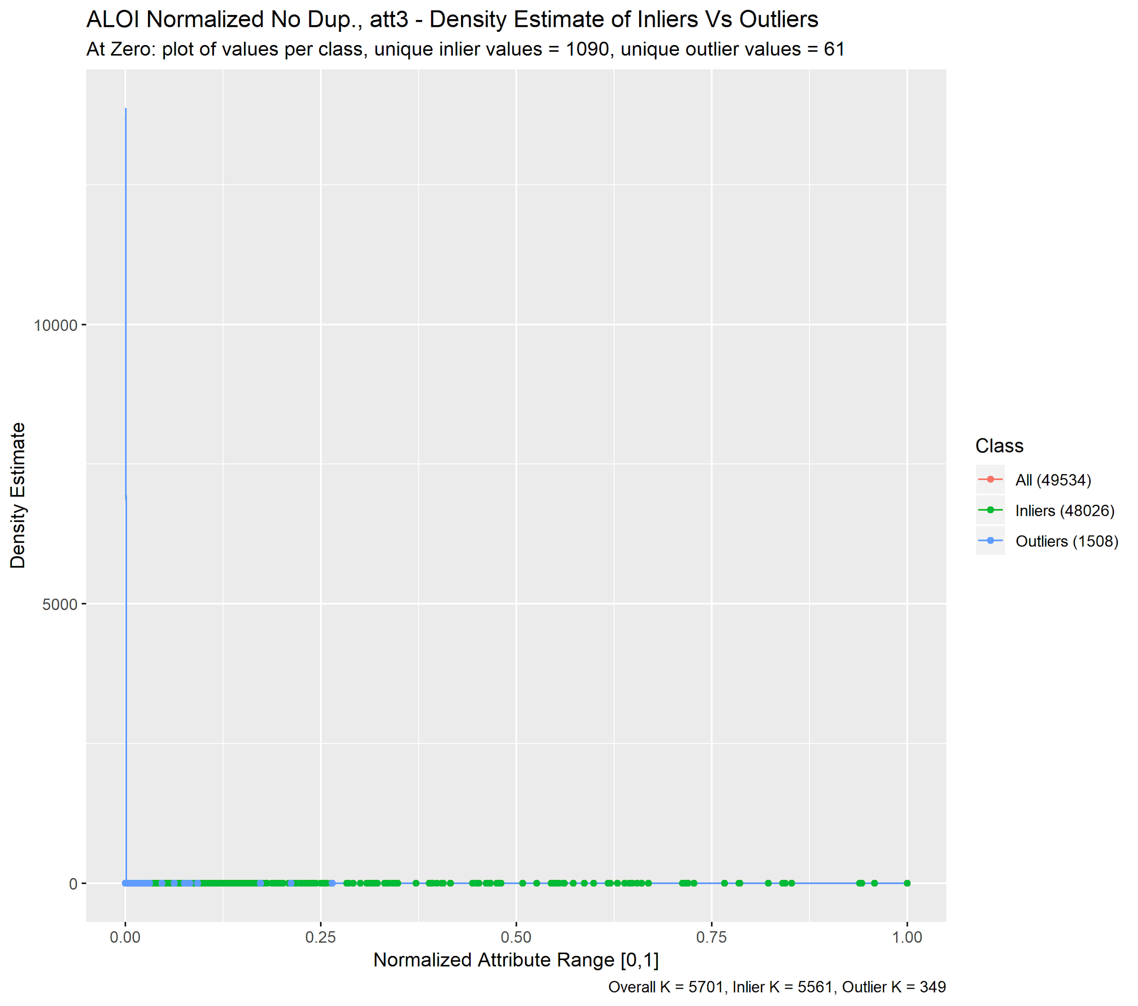
Density Estimation (Examples)
ALOI – Another Type of Typical attribute, forms an uneven distribution fraying into edges. ALOI dataset characterized by almost all attributes having similar form.
Comparing with parallel plot later, attributes density weighted towards lower bound, yet many marked inliers occupy upper bound.

Slide 8
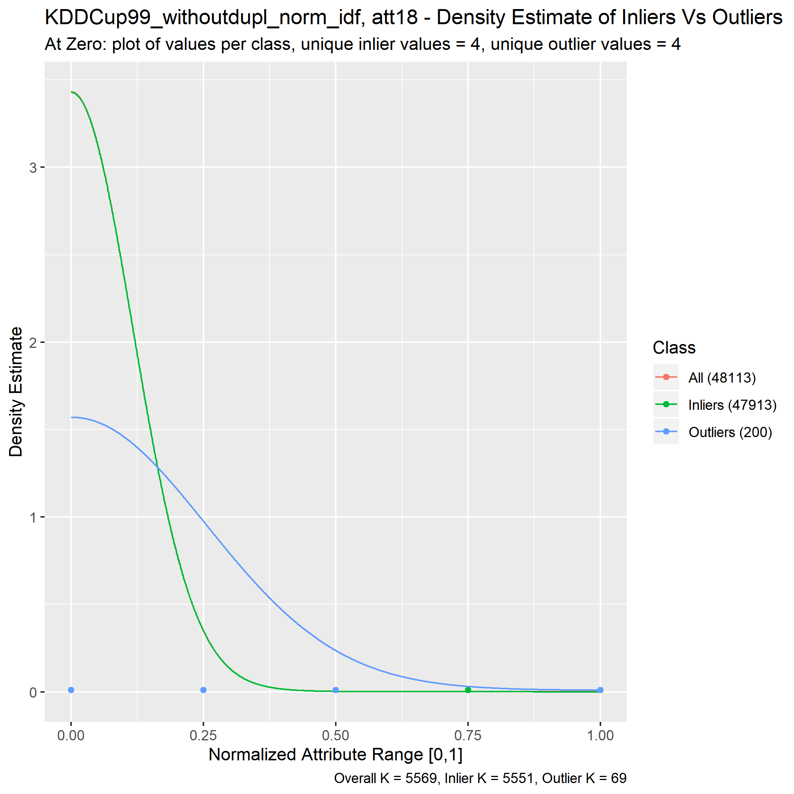
Density Estimation (Examples)
KDDCup – Example of Low Res. Attribute, dataset had many similar attributes, more than stated 3 categorical attributes had either binary values or categorical like attributes. This could be just due to the normalization process but in effect, they render the attributes to be “discrete separators”.

Slide 9
Parallel Coordinates Plots
Found this as method to visualize high-dimensional data.
Compared outliers to inliers.
Look into results with density estimates, and k-means clustering as complementary.
Goals:
Check quality of outlier labeling:
See if there is a good separation between inliers and outliers.
Check if outlier labeled to definition (something suspected of another generating process …)
Results:
Outlier labelling favors certain attributes in some datasets.
There appears to be equally interesting “inliers”

Slide 10
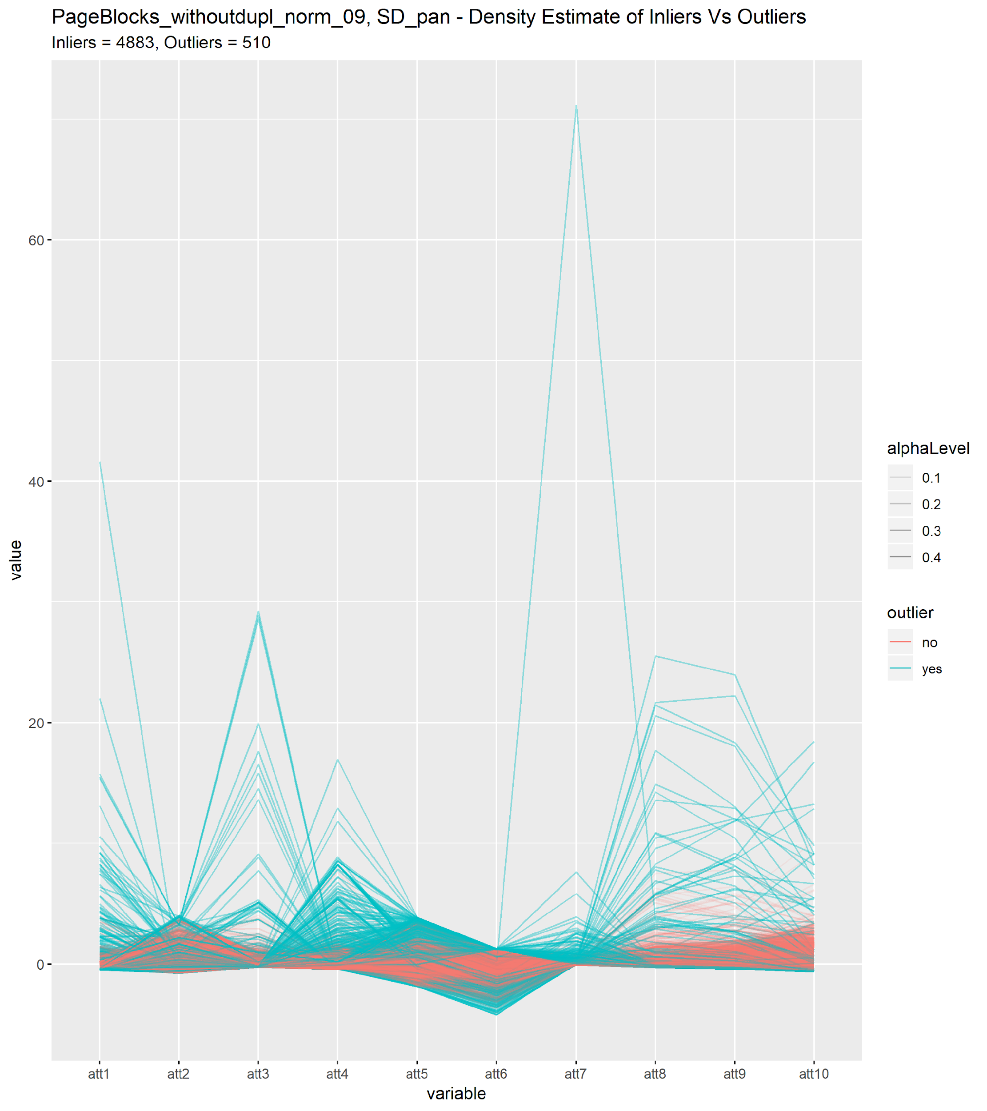
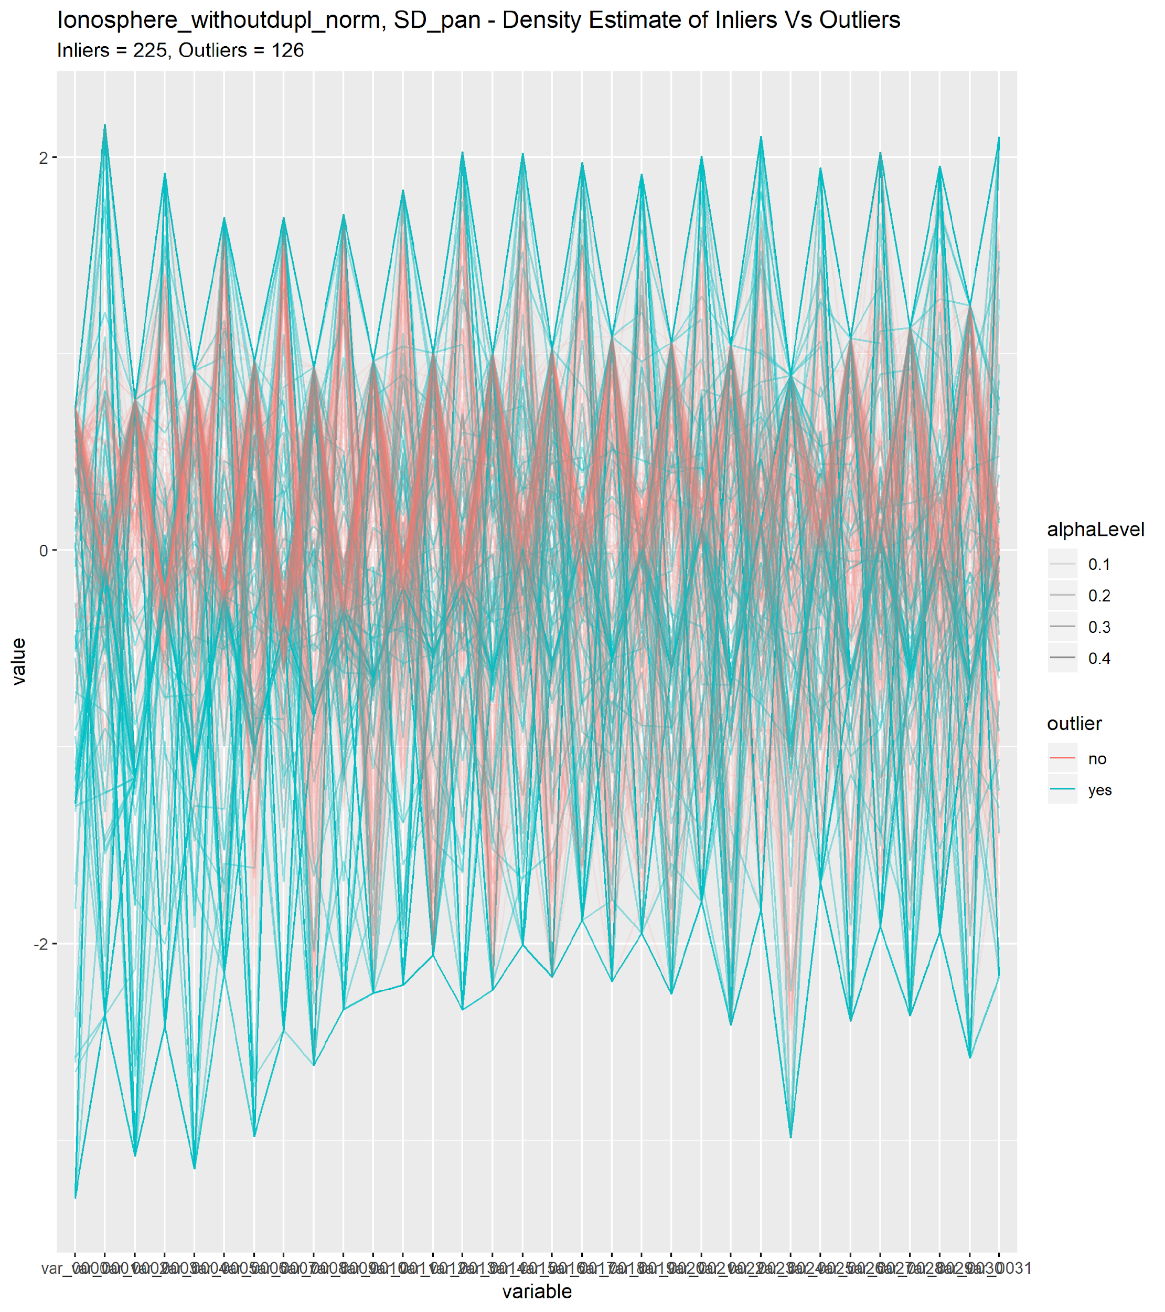
Parallel Coordinates (Examples)
Good examples of Outlier labelling. Label appears to capture separation between some process in Ionosphere and novel values in PageBlocks.

Slide 11
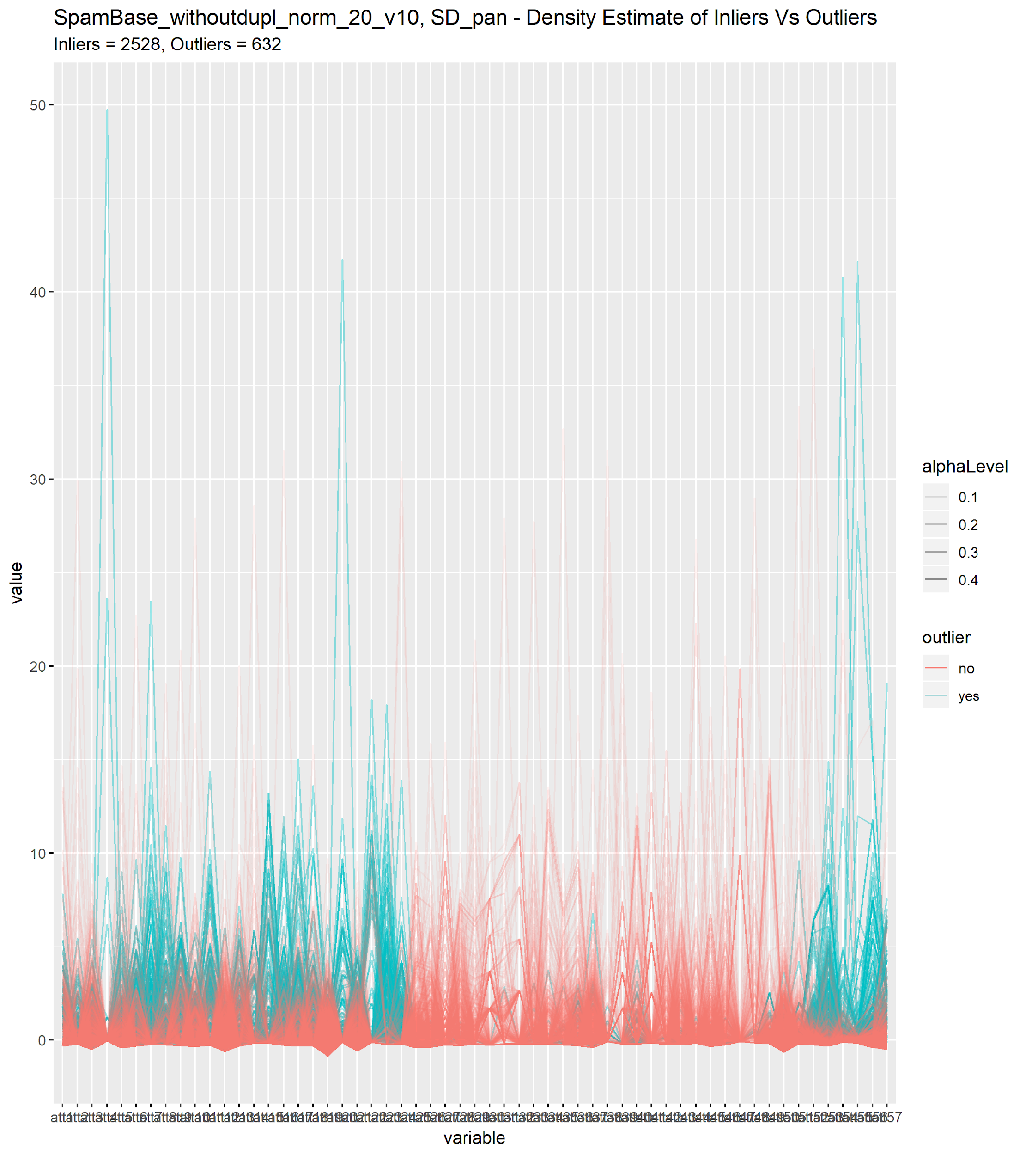
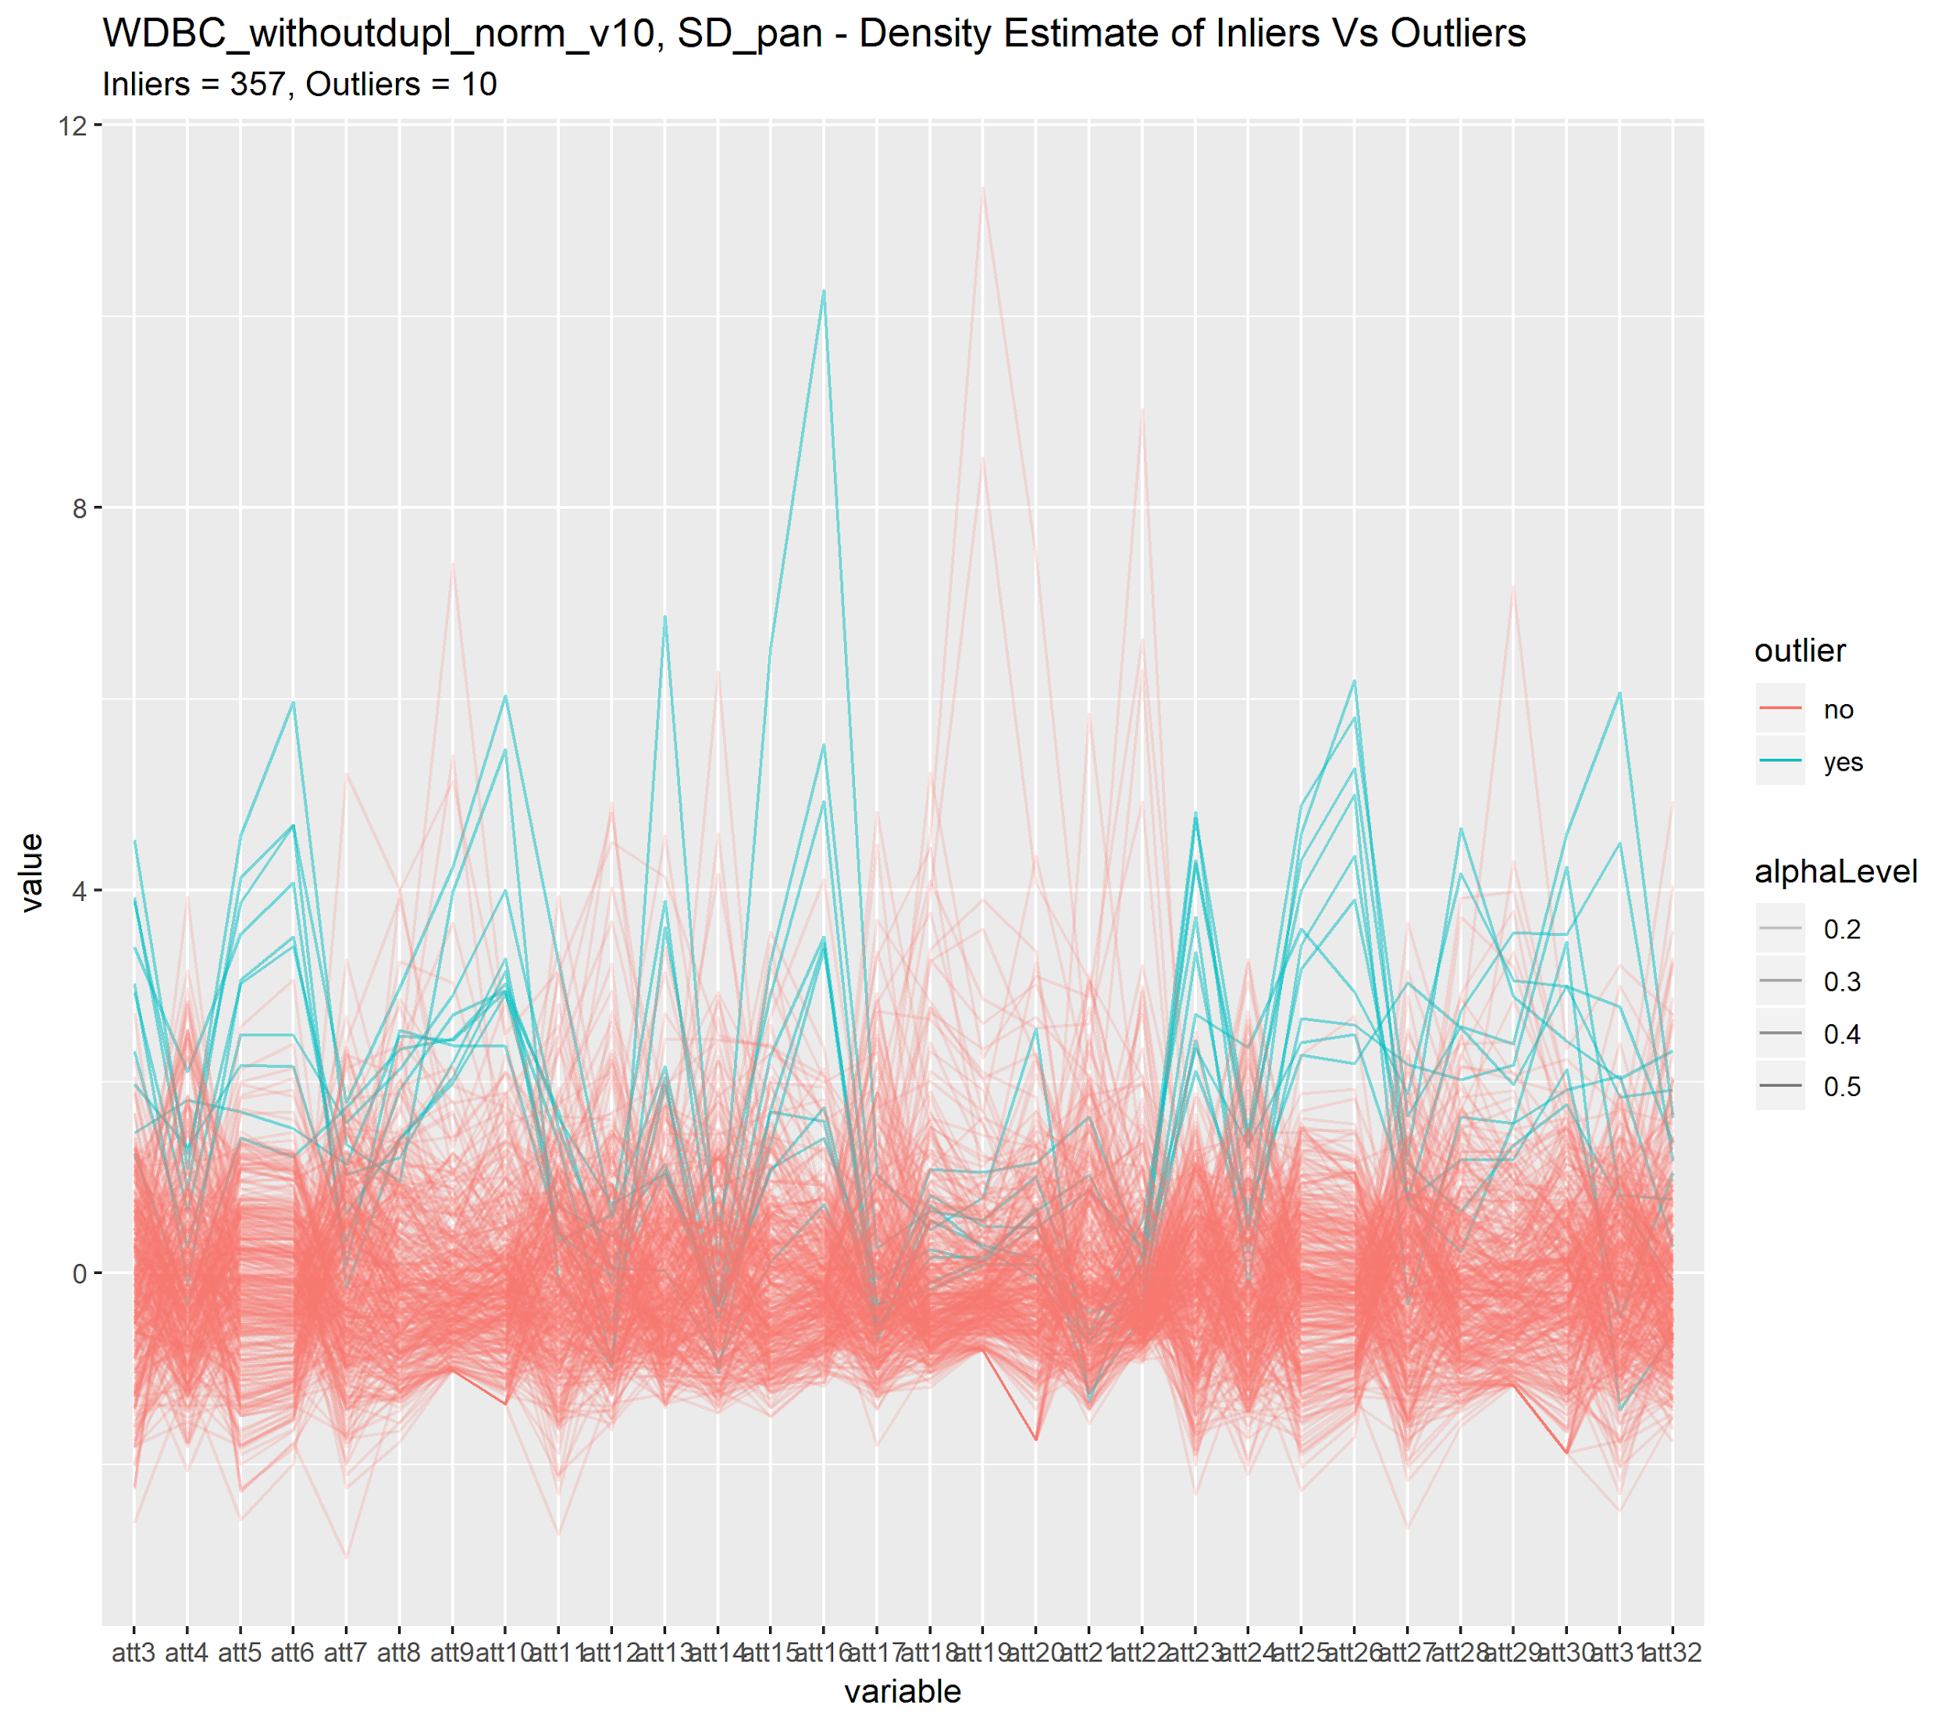
Parallel Coordinates (Examples)
Examples of bias in outlier labeling. Labelling of outliers appear to depend on a subset of attributes. At a glance, there appears to be interesting extreme values in WDBC there aren’t labelled as outliers. Spambase appears to contain a range of attributes unused for outlier labelling, appears to contain some extreme values which may be novel.

Slide 12
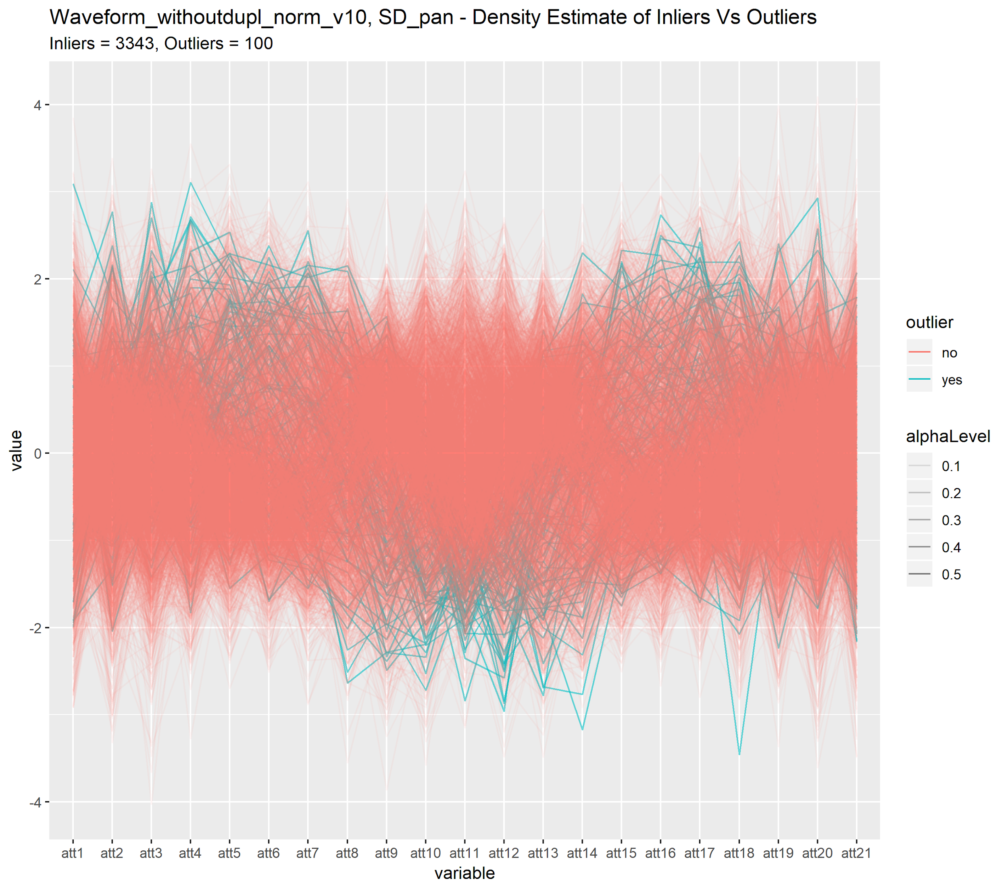
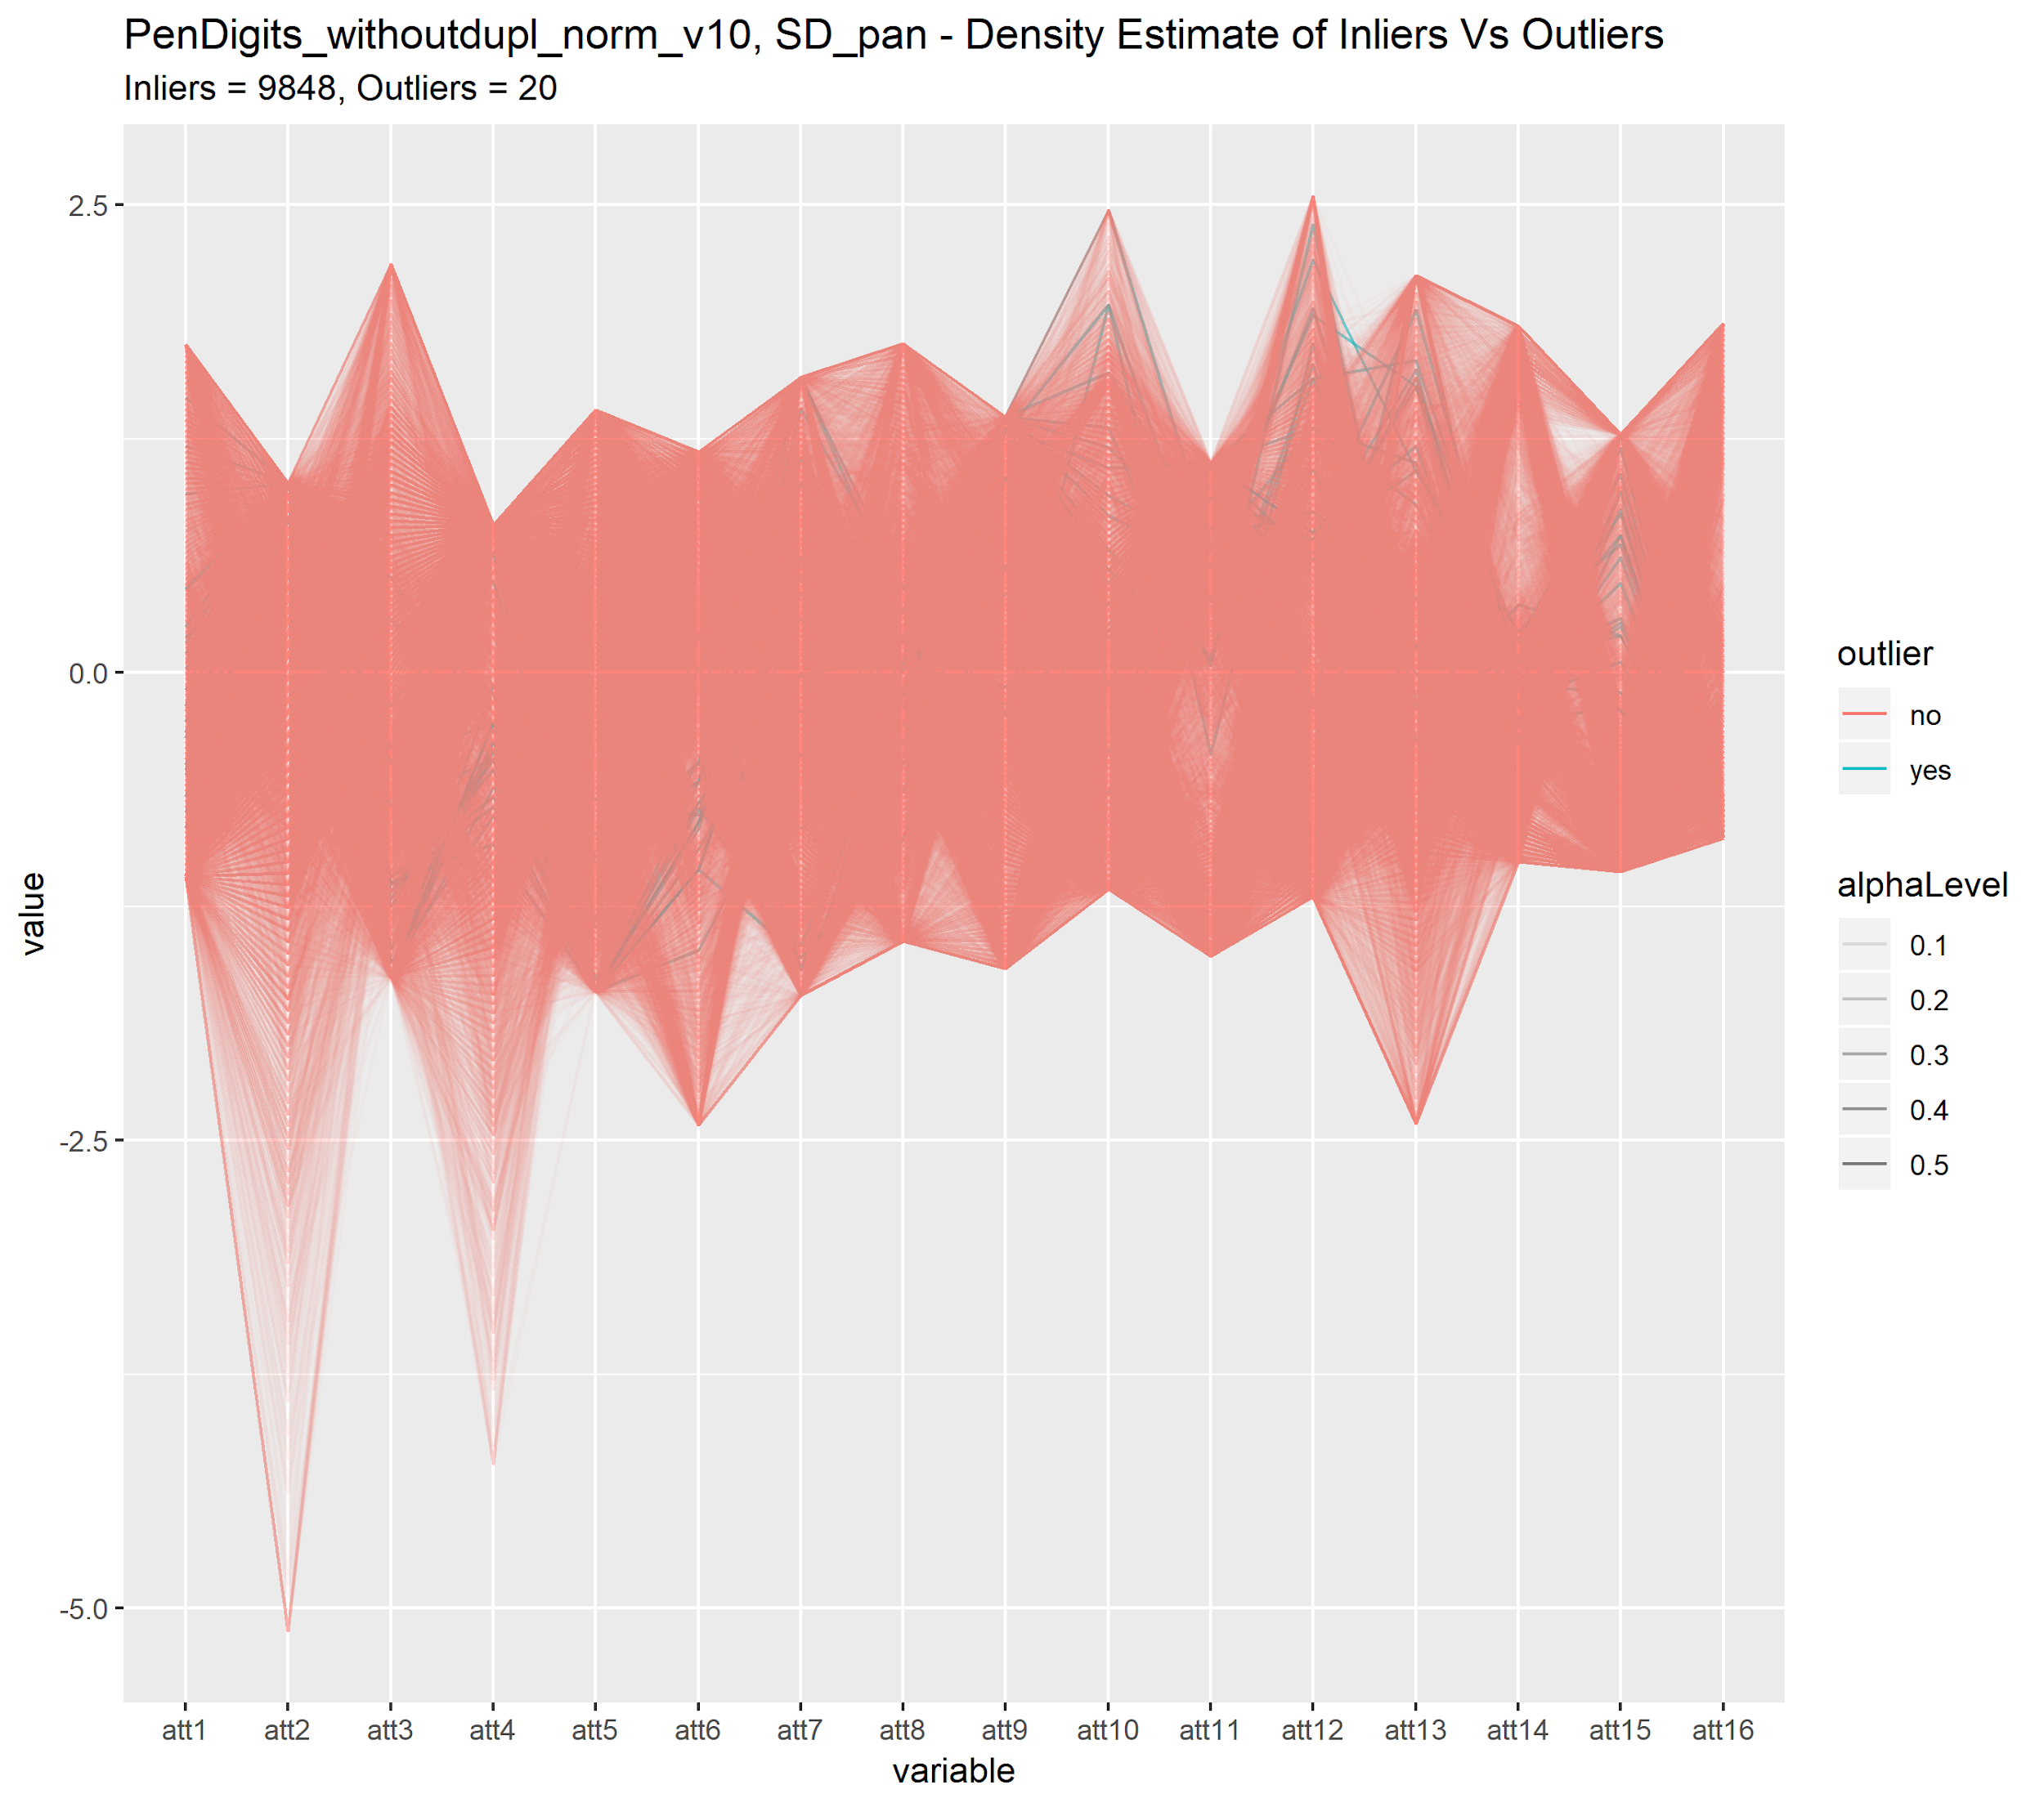
Parallel Coordinates (Examples)
Some other interesting examples…
Inliers in both datasets appear to follow a very strict mapping between attributes. Outliers are values that deviate from this mapping? This pattern makes labelling and detection different than that of others.
Both arise from a classification dataset. May be more useful to compare outlier scoring per regular class than as whole?

Slide 13
K-Means Clustering
Ran K-Means, using varying K on datasets.
Originally tried to use measures of clustering performance.
Found package Nbclust that generates a variety of clustering metrics.
Nbclust either returned very small cluster sizes (k=2) or very large k sizes … not too helpful.
Tried K between 1-20, also tried using multiple starts for some stability…
Goals:
Generate something to complement previous methods …
Results:
Good outlier labelling should result in two patterns:
Outliers form some minor cluster within dataset.
Outliers are suspect in that as whole they seem to be generated by some other process.
Outliers are generally uniformly spread across clusters.
Outliers are more-so novel observations in contrast to cluster.

Slide 14
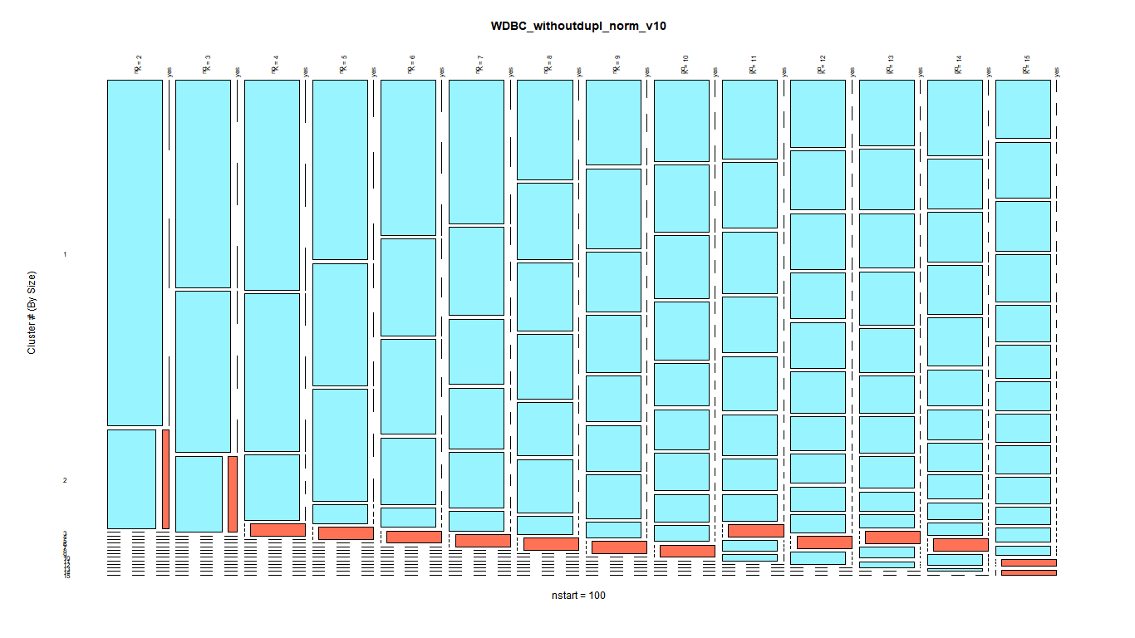
K-Means (Examples)
Good example of outliers forming a minor cluster, very stable separation between outliers and inliers.
Outlier Labelling in WDBC dataset seems mostly appropriate. Might be too conservative, bias towards some attributes.
Raises some questions about labelling, could other minor clusters be classified as outliers. Would this be consistent with outlier detection methods and the extreme values in the parallel plot?

Slide 15
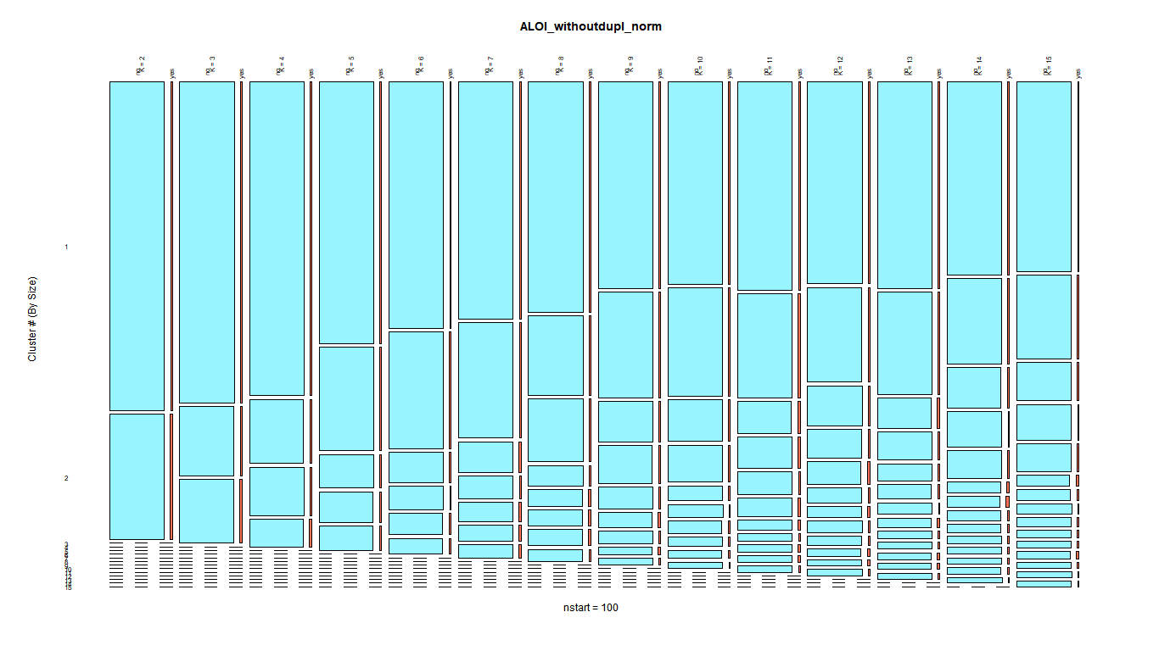
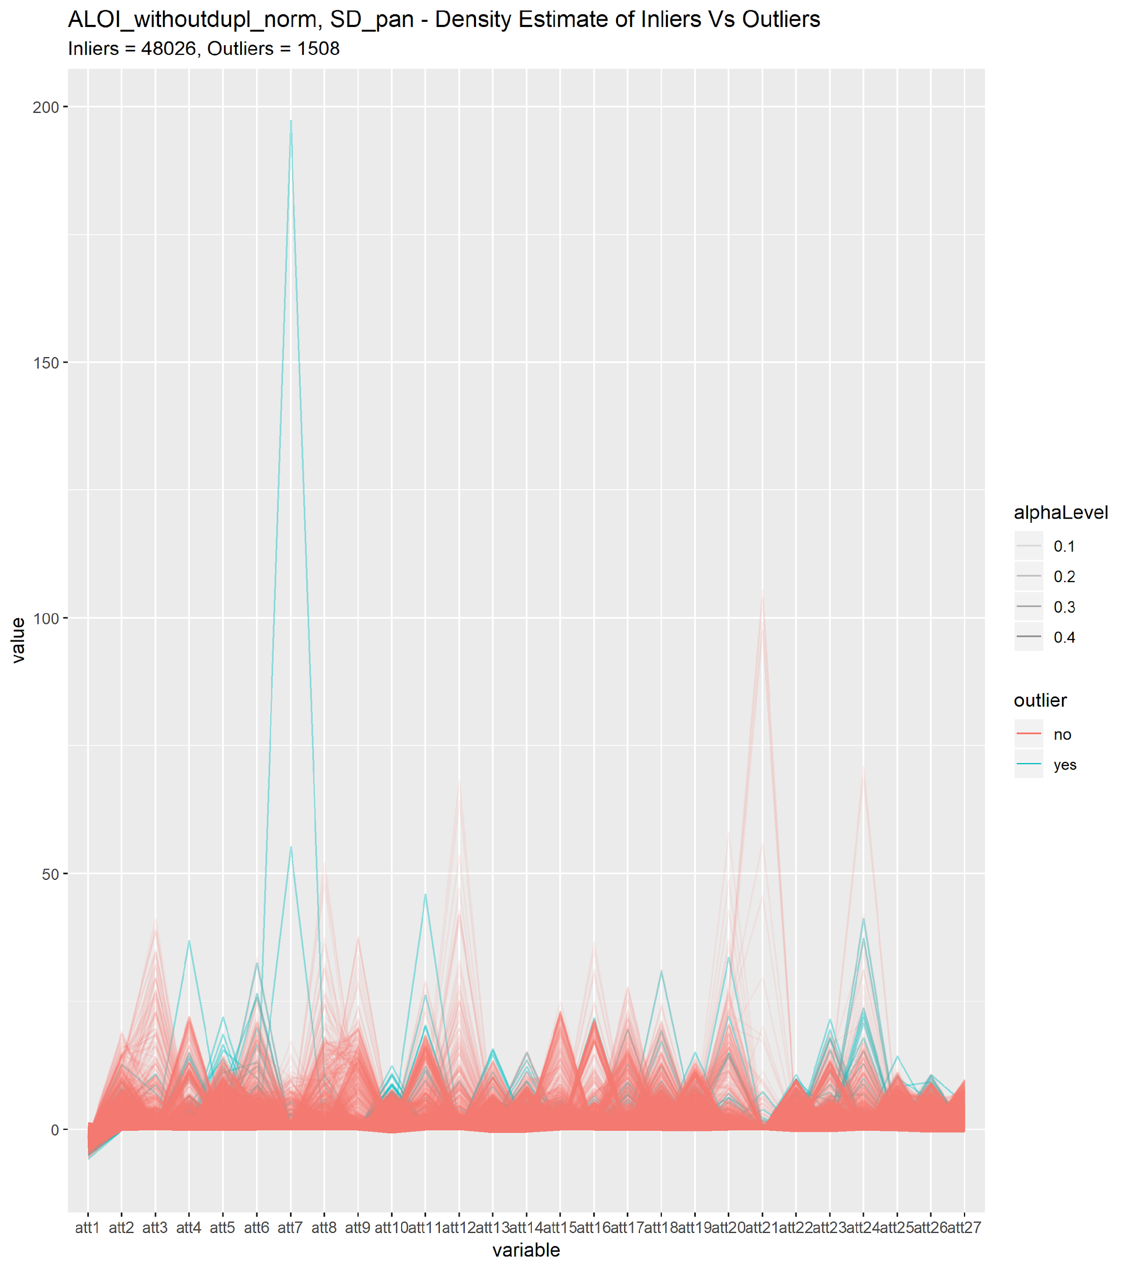
K-Means (Examples)
Good example of outliers uniformly spread amongst clusters. ALOI dataset might take form of some n-sphere with really dense center fraying into edges. Intuitively to this picture of the dataset, outliers should be the fairly well spread around the edge of the hypersphere.
Still labeling might be too conservative.

Slide 16
K-Means (Examples)
Good example of outliers uniformly spread amongst clusters. ALOI dataset might take form of some n-sphere with really dense center fraying into edges. Intuitively to this picture of the dataset, outliers should be the fairly well spread around the edge of the hypersphere.
Still labeling might be too conservative.

Slide 17
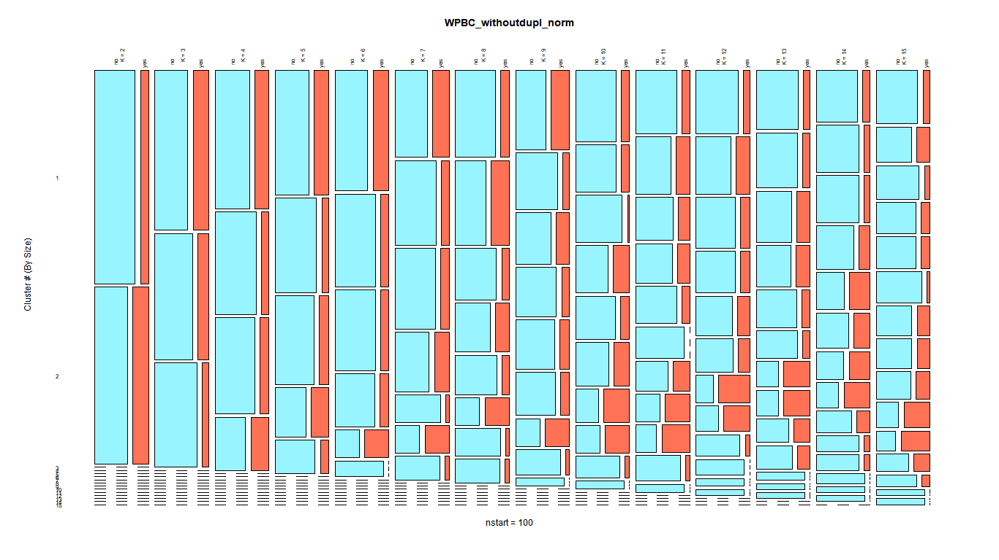
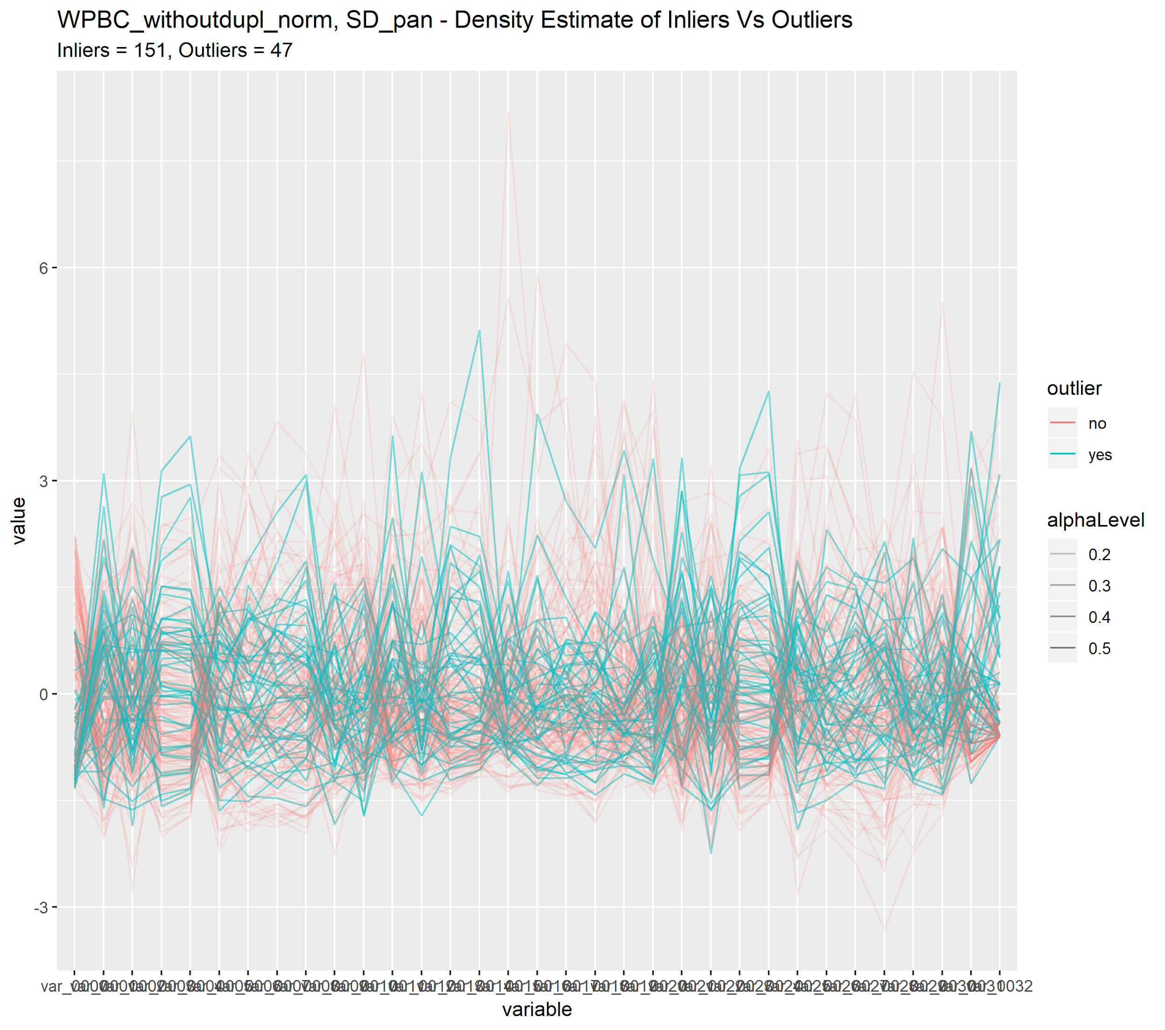
K-Means (Examples)
Example of bad outlier labelling. WPBC had best ROC_AUC of ~0.58. Paper seems to deal with certain “high contrast” subspaces of data, proposes some pre-processing step.
Dataset raises some questions on what do traditional outlier detection schemes pick up here?

Slide 18
Stuff To Do
Find way to get per point silhouette scores...
Find way to combine scores into plots …
New Approaches:
Try alternative clustering methods.
HDBSCAN w/ varying cut levels
Try dimensionality reduction methods.
PCA, etc … Not familiar with these
See what do outlier detection methods pick-up in parallel plots, K-means plots, new approaches etc …
See if outlier labels more appropriate for subspaces of datasets.
See if there’s a better way to expand / contract outlier labeling?
For example, if one point is labeled an outlier for k, can I find another point labeled in inlier for the same k for some metric?

